Slide 1

ENV 107
Introduction to
Environmental Science
Climate Change
North South University

Slide 2
Key Terms
Climate
The total of all weather occurring over a period of years in a given place. It is the average weather condition of that place.
Weather
Weather is all around us. Weather describes whatever is happening outdoors in a given place at a given time. It can change a lot within a very short time. For example, It can be windy at night, rainy in the morning, hot and sunny at noontime, and even back to windy before sunset. It includes daily changes in rainfall, temperature and wind in a given location.

Slide 3
Global Warming
Global warming refers to the rising average temperature of Earth's atmosphere and oceans and its projected continuation.
In the last 100 years, Earth's average surface temperature increased by about 0.8 °C (1.4 °F) with about two thirds of the increase occurring over just the last three decades.
Scientists are more than 90% certain most of it is caused by increasing concentrations of greenhouse gases produced by human activities such as deforestation and burning fossil fuel
The temperature at or near the surface of the Earth is determined by four main factors:
The amount of sunlight Earth receives.
The amount of sunlight Earth reflects.
Retention of heat by the atmosphere.
Evaporation and condensation of water vapor.

Slide 4
Global Warming
All the expected long range effects of recent global warming induced climate change like rising sea levels, glacier retreat, Arctic shrinkage, and altered patterns of agriculture are actually cited as direct consequences of human activities.
Burning of fossil fuel, increase of industrial pollutants and deforestation are the human activities that are responsible for this global warming.
Solar Energy provides most of Earth’s energy
50% of solar energy reflected or absorbed by clouds. 45% is absorbed by surface, 5% is reflected. Absorbed (short wavelength) solar energy is “returned” to space by re-radiation as (long wavelength) infrared energy.

Slide 5
Global Warming: The Greenhouse Effect
The Greenhouse effect is the process by which absorption and emission of infrared radiation by gases in the atmosphere warm a planet's lower atmosphere and surface.
It was proposed by Joseph Fourier in 1824 and was first investigated quantitatively by Svante Arrhenius in 1896.
Sunlight that reaches Earth warms both the atmosphere
and the surface. Earth’s atmosphere system then radiates heat as infrared radiation.

Slide 6
Global Warming: The Greenhouse Effect
Water vapor and several other gases, including carbon dioxide, methane, and Chloro-Fluoro carbons (CFCs), warm Earth’s atmosphere because they absorb and reemit radiation.
They trap some of the heat energy radiating from Earth’s atmospheric system.
The trapping and warming is somewhat analogous to a greenhouse, which also traps heat; thus the process has been called the greenhouse effect.

Slide 7
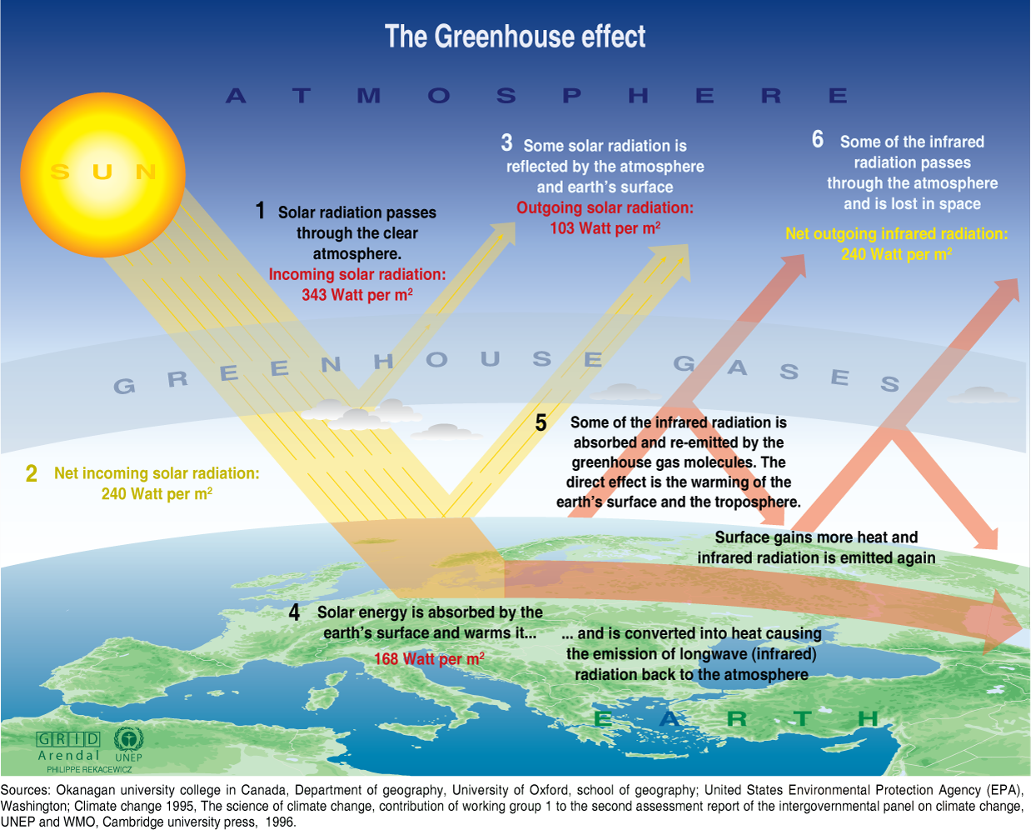
Global Warming: The Greenhouse Effect

Slide 8
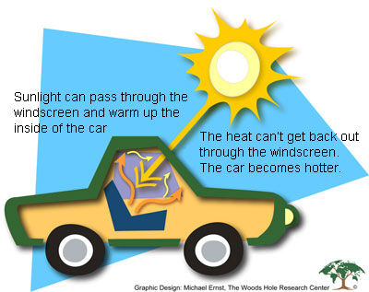
Global Warming: The Greenhouse Effect
Imagine… a car on a cool but sunny day…

Slide 9
Global Warming: The Greenhouse Effect
Because carbon dioxide, CFCs, methane, nitrous oxides, and ozone absorb infrared radiation emitted from earth, it has been hypothesized that earth may be warming because of the increase of these anthropogenic greenhouse gases.
Following two factors increase greenhouse gases:
  The burning of fossil fuels which adds about 5.4 billion metric tons of carbons each year to the atmosphere and deforestation which adds another 1.6 billion metric tons per year increasing concentration of atmospheric CO₂.
  Human activities that emit other greenhouse gases such as CFCs , ozone , methane and nitrous oxide.

Slide 10
Causes of Global Warming
Natural processes
  Release of methane gas from arctic tundra and wetlands
  Release of carbon dioxide gas, ashes etc. from Volcanoes
  Tectonic plate movement
  Changes in the sun
Human activities – any activity that releases “greenhouse gases” into the atmosphere

Slide 11
Global Warming: The Greenhouse Effect
Major Greenhouse gases
Any gases that cause the “greenhouse effect!”
Carbon dioxide
Methane
Nitrous oxide
Water vapour
Chlorofluorocarbons

Slide 12
Greenhouse Gases - Sources
The main sources of greenhouse gases due to human activity are:
Burning of fossil fuels and deforestation leading to higher carbon dioxide concentrations in the air. Land use change account for up to one third of total anthropogenic CO₂ emissions.
Livestock enteric fermentation and manure management, paddy rice farming, land use and wetland changes, pipeline losses, and covered vented landfill emissions leading to higher methane atmospheric concentrations.
Use of chlorofluorocarbons (CFCs) in refrigeration systems, and use of CFCs in fire suppression systems and manufacturing processes.
Agricultural activities, including the use of fertilizers, that lead to higher nitrous oxide (N₂O) concentrations.

Slide 13
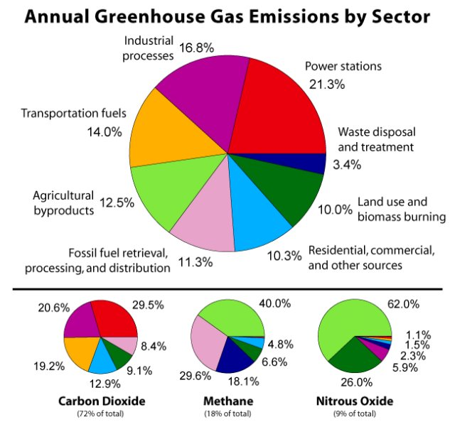
Greenhouse Gases - Emissions
Global anthropogenic greenhouse gas emissions: 8 different sectors for the year 2000

Slide 14
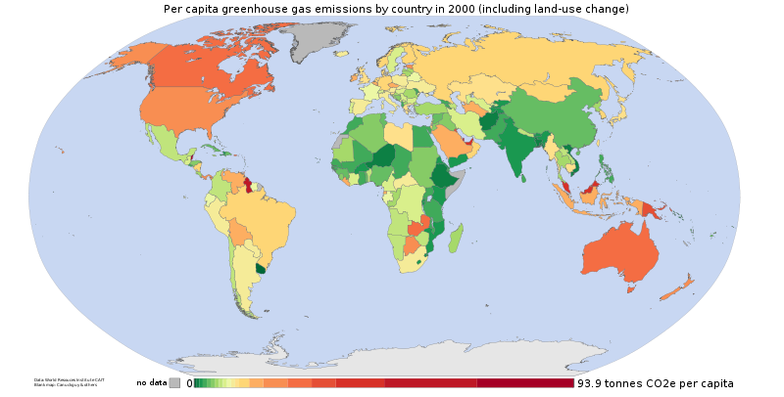
Greenhouse Gases - Emissions
Per capita anthropogenic greenhouse gas emissions by country for the year 2000

Slide 15
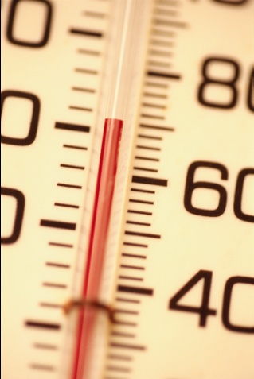

Difference
GLOBAL WARMING
is the increase of the Earth’s average surface temperature due to a build-up of greenhouse gases in the atmosphere.
CLIMATE CHANGE
is a broader term that refers to long-term changes in climate, including average temperature and precipitation.

Slide 16
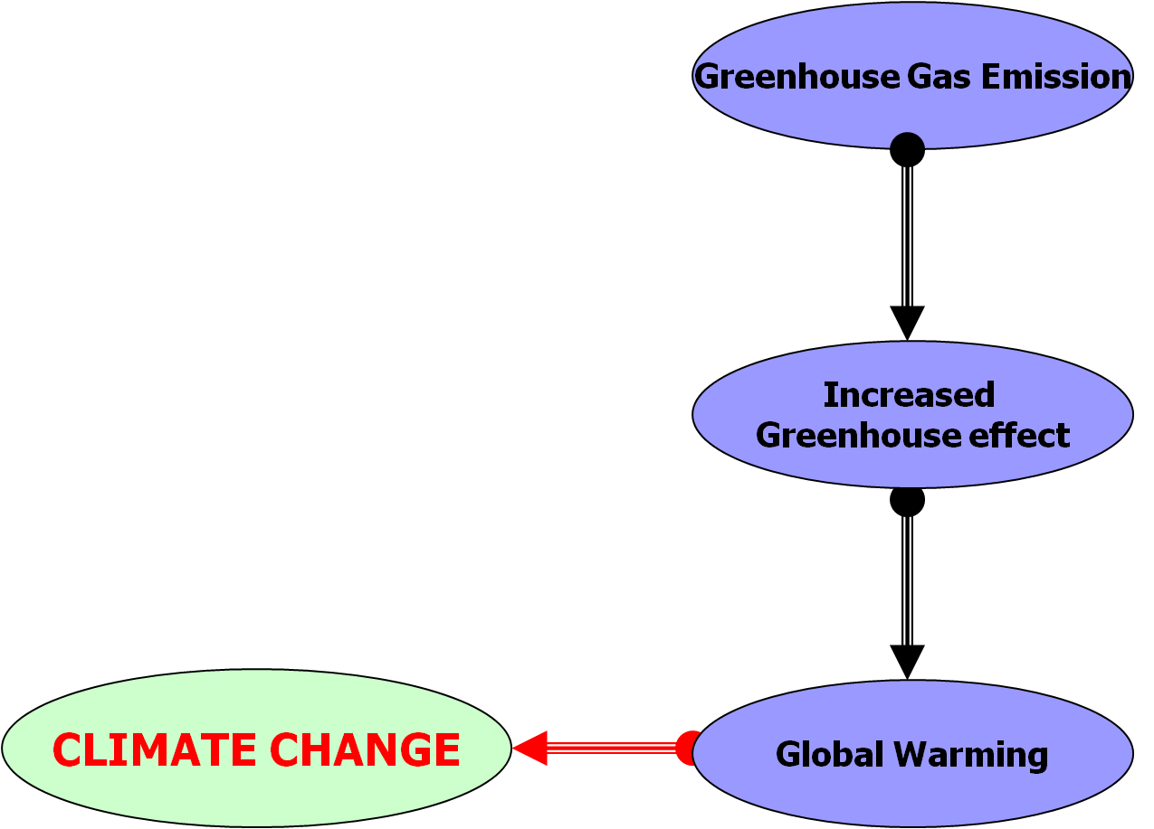
Global Warming leads to
Climate Change

Slide 17
Climate Change
Mean annual temperature of the earth has swung up and down by several degrees Celsius over the past million years.
Starting in 1850, a warming trend became apparent , lasting until the 1940s, when temperatures began again cool.
From 1960 to 1990 temperature has increased steadily.
It is evident from the last 100 years is that global mean annual temperature has increased by approximately 0.5 to 1.2 0C.

Slide 18
Global Warming - Potential Effects
Changes in Climate pattern
  Global rise in temperature is expected to significantly change patterns of rainfall, soil moisture, and other climatic factors related to agricultural productivity.
Rise in Sea Level
  The result is rising sea and water levels, causing floods and massive destruction to low-lying towns and cities along water bodies.
Changes in plant and animal distribution
  Climate change also distorts the natural habitats and lives of many plants and animals. For example, the survival of polar bears and penguins in icy regions are in danger
Human health
  Extreme changes in temperature makes people suffer breathing difficulties, head aches, body rashes and other illnesses.

Slide 19
Global Warming - Potential Effects
  Food Production
  Climate change is projected to decrease agricultural productivity in the tropics and sub-tropics for almost any amount of warming. Countries will face malnutrition problems as food production will decrease due to frequent droughts and floods.
  Biomass/Forest Management
  Managing forest will become more challenging difficult due to an increase in pests, fires and irregular rainfall.
  Water Scarcity
  One third of the world’s population is now subject to water scarcity. Climate change is projected to decrease water availability in many arid- and semi-arid regions

Slide 20
Climate Change & Bangladesh
UNFCCC identified Bangladesh as one of the most vulnerable countries of the world due to climate change because;
  geographic location;
  flat and low-lying topography;
  high population density;
  reliance of many livelihoods on climate sensitive sectors, particularly agriculture and fisheries;
Though Bangladesh emits a minuscule of GHG, in 2005 terms,- 0.053 to 0.045 billion tonnes
Developed countries -18.2 billion tonnes in 2005.

Slide 21
Climate Change Impacts in Bangladesh
Temperature extremes
Erratic rainfall
Increased number of severe flood
Increased frequency of cyclone and salinity intrusion
More river bank and coastal erosion
Population Vulnerable to Impact of Climate Change
Barind Tract: Drought (5.038 million people under threat)
Haor Basin: Flash Flood (20 million people under threat)
Water logging and permanent inundation due to Sea Level Rise (SLR)

Slide 22
Dealing with the Climate Change
Solutions
There are two basic adjustments:
Adaptation; that is, do nothing to combat it, and live with future global climatic change.
  Work to mitigate the situation (reduce its severity) by reducing emissions of greenhouse gases.
    Renewable energy sources, farm practices to
    protect soil integrity, preventing deforestation
  Both are necessary

Slide 23
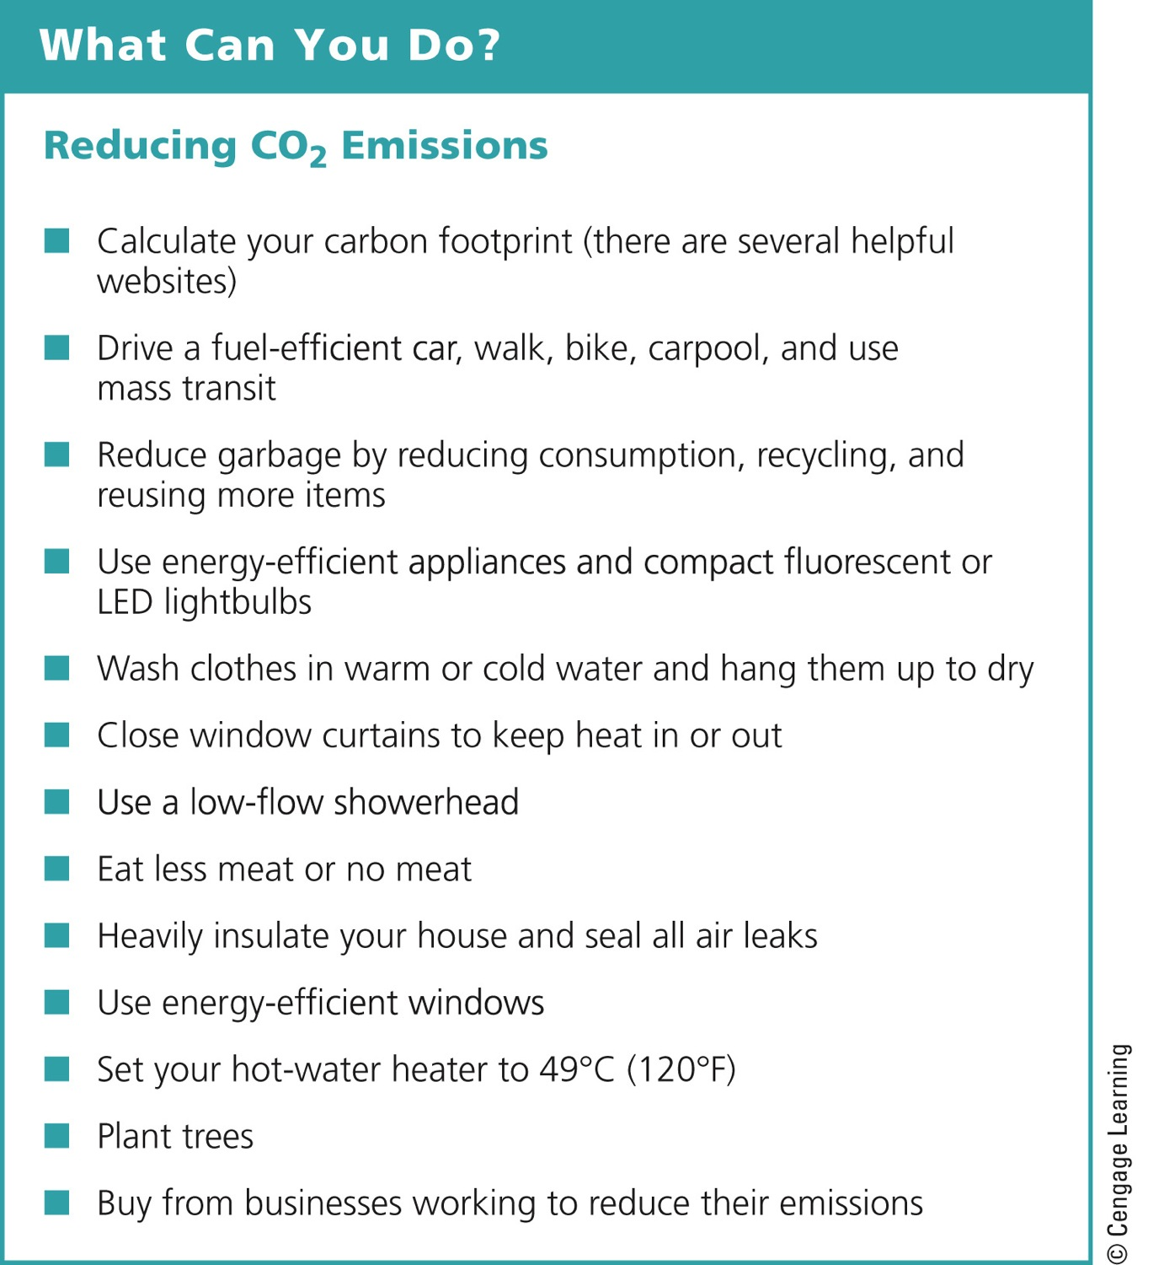
Notes:
Figure 19-28: Individuals matter: You can reduce your annual emissions of CO₂. Question: Which of these steps, if any, do you take now or plan to take in the future?

